Slide 1
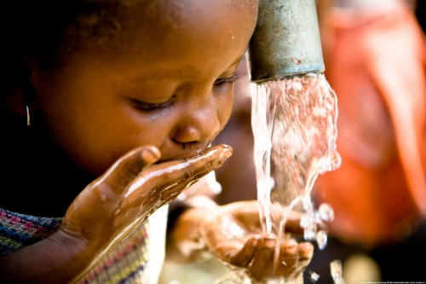
To what extent could global access to clean water contribute to the elimination poverty?
Linking with Document 4, Global Perspectives Pre-Release Material

Slide 2
Key terms
Global access
Local supplies of fresh water to every region in the world populated by people
Clean Water
Drinking water of sufficiently high quality that it can be consumed or used without risk of immediate or long term harm
Eliminate
Permanently remove
Poverty
Severe deprivation of basic human needs

Slide 3
Document 4 - A report produced by Water Aid
“Water is a key social and economic resource for any nation”
“Water is key to improved health, improved nutrition and quality of life”
Inference: Health, nutrition and quality of life are important factors in overcoming poverty
Conclusion
“Water and sanitation make a vital contribution to poverty elimination”
Document 4, Cambridge Pre-U Global Perspectives Paper 3 Presentation Pre-Release Material 2012, Adapted from “The Human Rights Based Approach to Development”.

Slide 4
Preliminary opinion
“There is a major correlation between poverty and deprivation of clean water sources.
Global access to clean water would mainly help to support life and do little to help eradicate the massively damaging effects of poverty in the modern world”.
“The main factors in overcoming poverty are education and the maintenance of human rights”
Personal perspective: Western, Practical

Slide 5
Medical Perspective
These diseases prevent whole countries from developing
Water-borne diseases effect many people in the same region
Humans are dependent upon clean water for health
“Water-borne diseases are caused by drinking water contaminated with faeces”
“Water-washed diseases such as trachoma are caused by poor hygiene and skin or eye contact with contaminated water”
The World Water Council - http://www.worldvision.org.nz/pdf/resources/Water.pdf

Slide 6
The World Water Council
The World Water Council is an international organisation, established in 1996 on the initiative of renowned water specialists.
Their sources of information can be regarded as accurate due to the huge amount of research practiced over a number of years in a massive range of countries deprived of clean water.
Due to their interactive work with other countries being such a priority, Water Vision also have a humanitarian perspective.
This new approach opposes my initially practical and faceless perspective.
Water Vision Online - http://www.worldwatercouncil.org/index.php?id=192

Slide 7
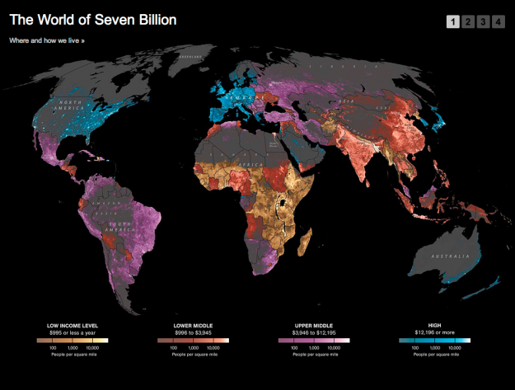
Walden Bello, Philadelphia Independent Media Centre http://phillyimc.org/en/seven-billion-and-rising

Slide 8
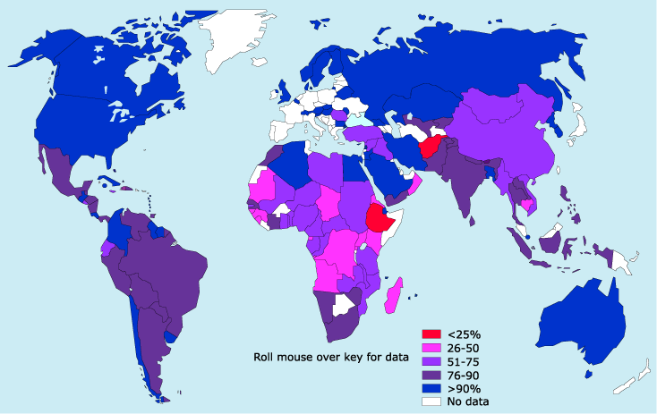
The percentage of the population with access to clean drinking water in 2000
Peter Gleick of the Pacific Institute for Studies in Development, Environment and Security
http://www.nature.com/nature/focus/water/map.html

Slide 9
Causes of poverty
Overpopulation
Inadequate Education and Employment
Global Distribution of Resources
Environmental degradation
Economic and Demographic Trends
Fight Poverty - http://www.fightpoverty.mmbrico.com/poverty/reasons.html
en.wikipedia.org/wiki/Dripirrigation

Slide 10
Governmental perspective
“Improving sanitation is often low on the list of priorities. There are so many other pressing needs for the attention of governments: food supply, education, medical treatment and dealing with war and conflict.”
WHO in cooperation with UNICEF and WSSCC
http://www.unwater.org/wwd08/docs/10Things.pdf

Slide 11
WHO/UNICEF
Thousands of health experts → balanced scope and objective viewpoint.
Global discussions → no vested interest in the presentation of evidence

Slide 12
Social Perspective
“Every day millions of women and young girls collect water for their families—a ritual that reinforces gender inequalities in employment and education.”
Human Development Report 2006 - The Human Development Report Office (HDRO)
http://hdr.undp.org/en/media/HDR06-complete.pdf

Slide 13
Further Research
The future of the water crisis:
environmental impact upon current strategies.
Other cultural aspects which hinder gender inequality

Slide 14
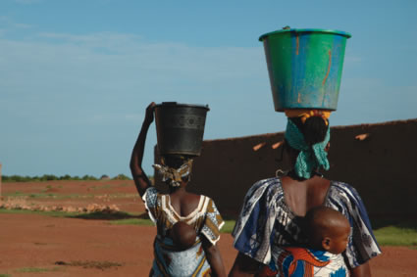
Final Perspective
Greatly influenced by the social perspective
The elimination of water as a governing strain enable incredible potential

